Slide 1
Sample CAD Portfolio
Keenan Fejeran 2016
keenanempire@gmail.com

Slide 2
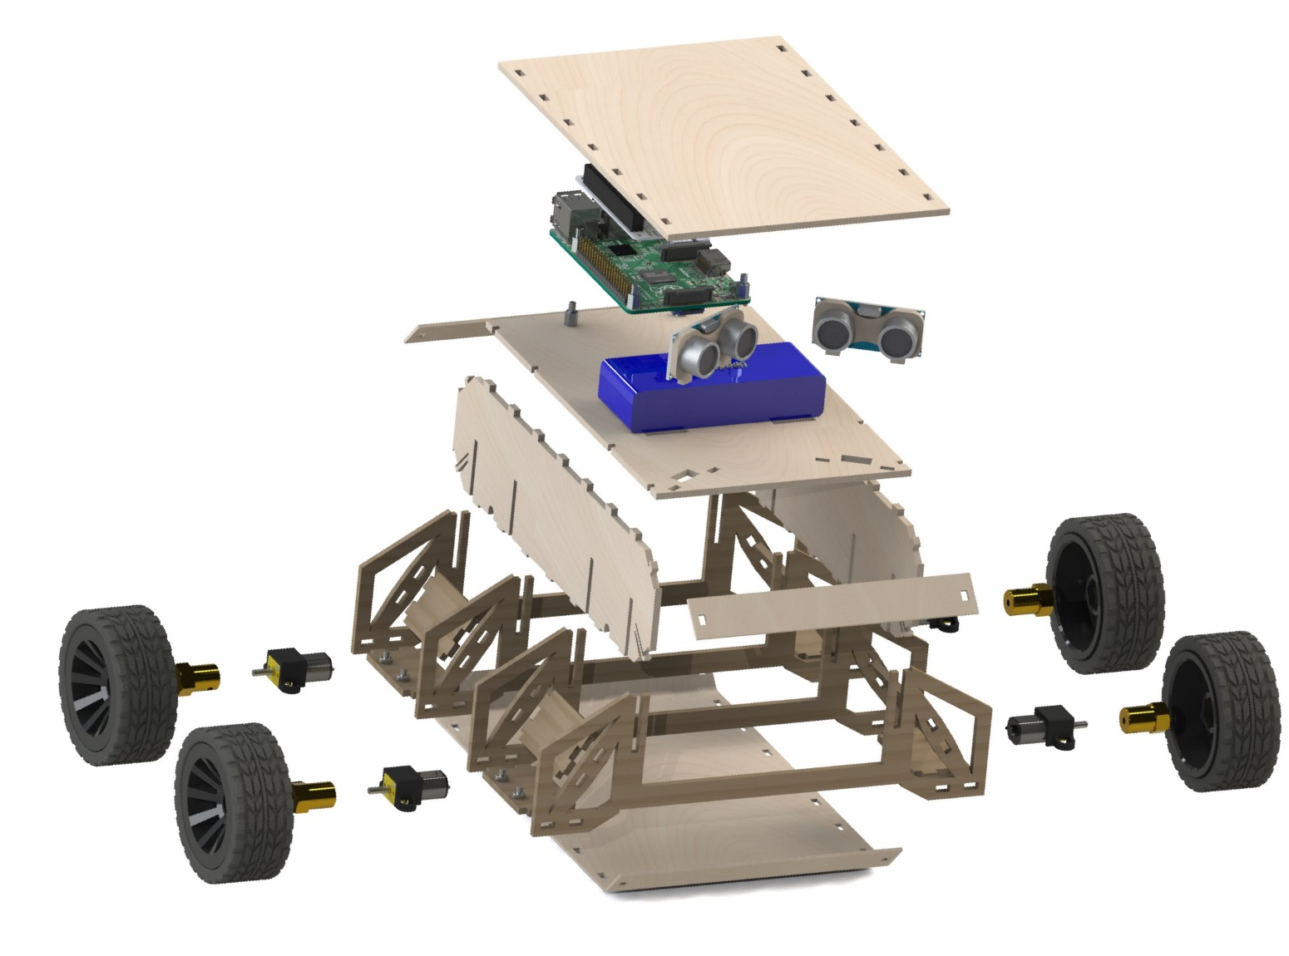
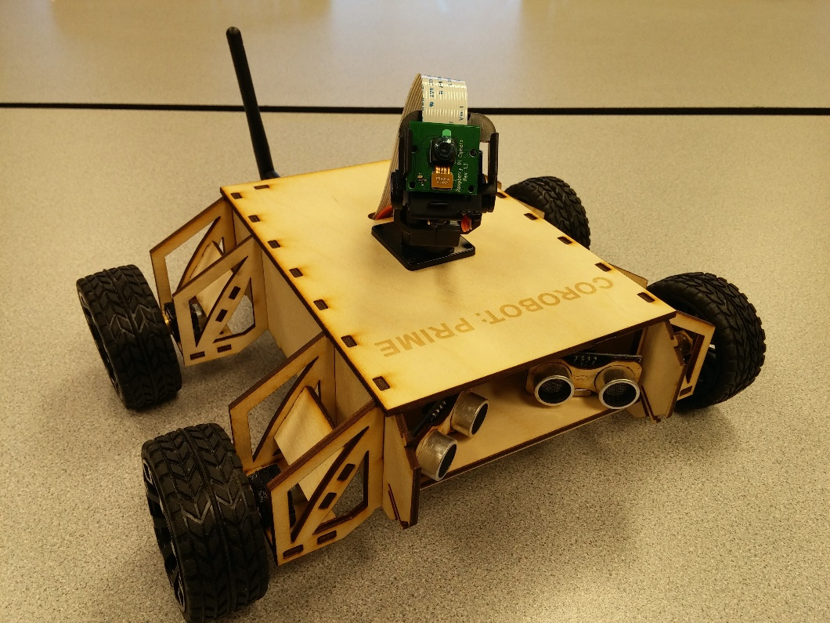
STEM Robot Chassis
Team leader and owner of CAD redesigns
Personally hand designed, manufactured, tested and redesigned dozens of iterations

Slide 3
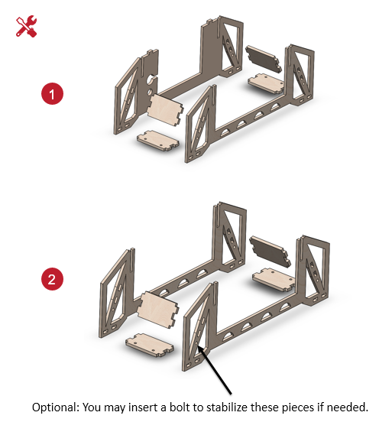
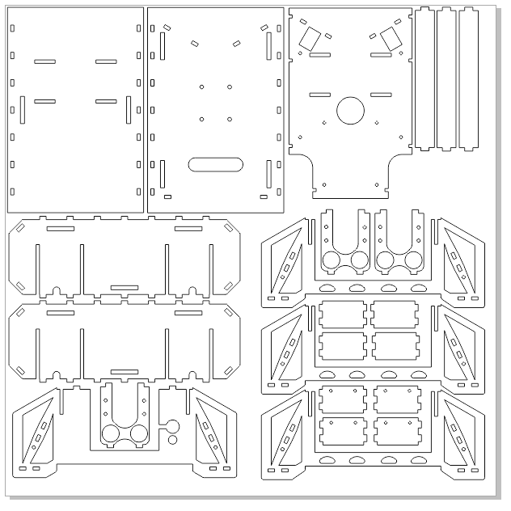
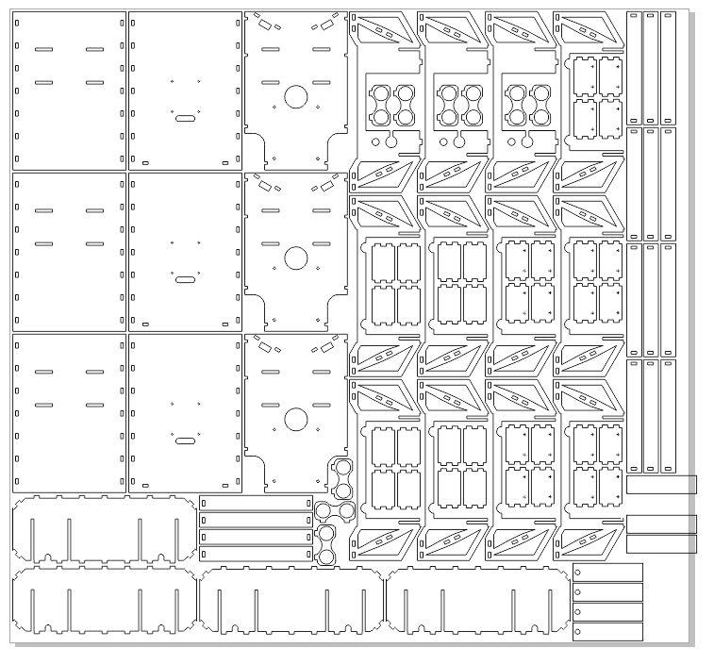
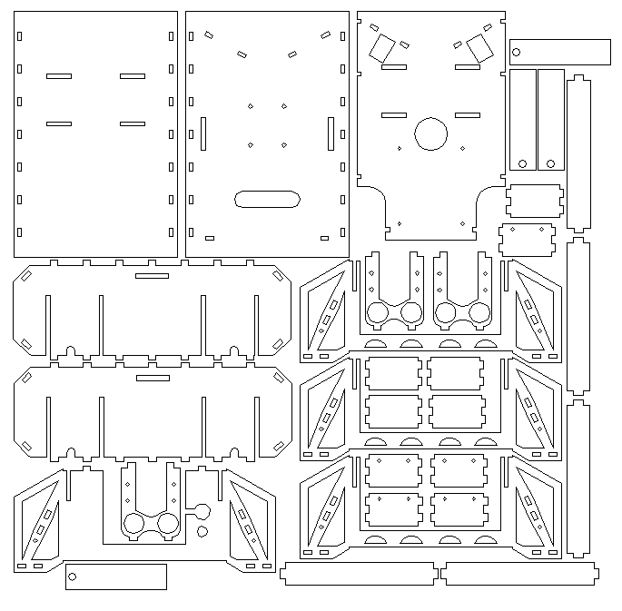
STEM Robot Chassis
Assembly guide creation and user testing
Dozens of archived and organized iterations

Slide 4
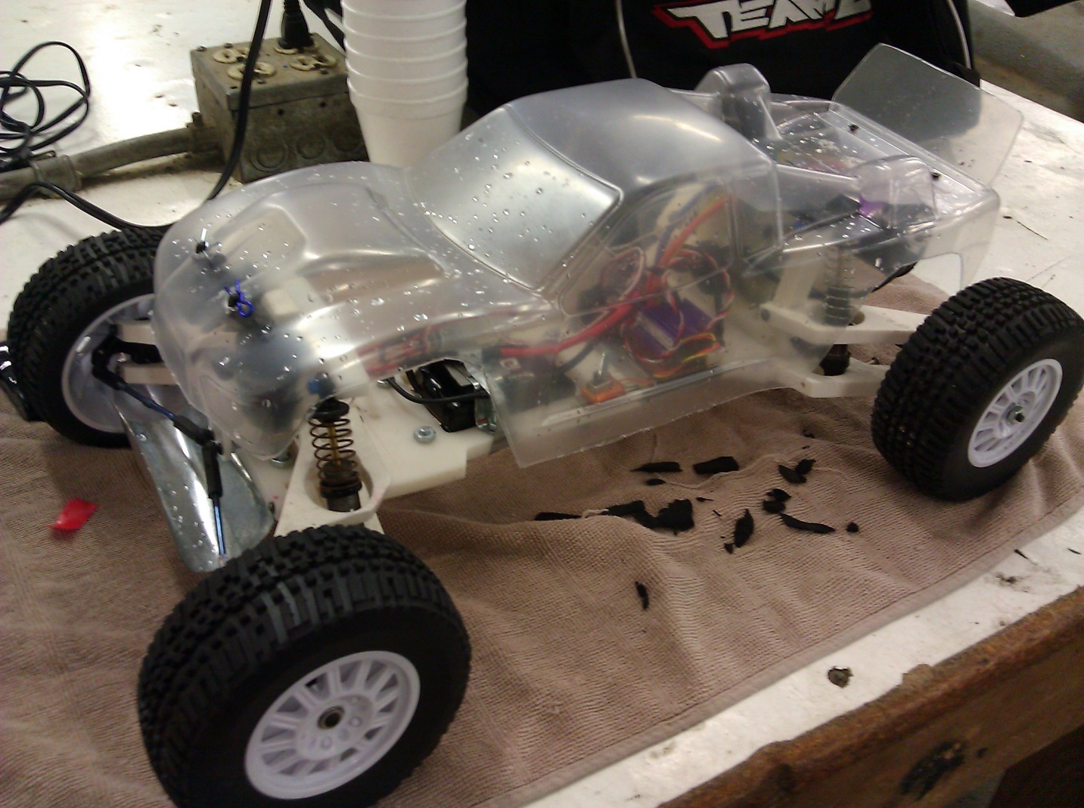
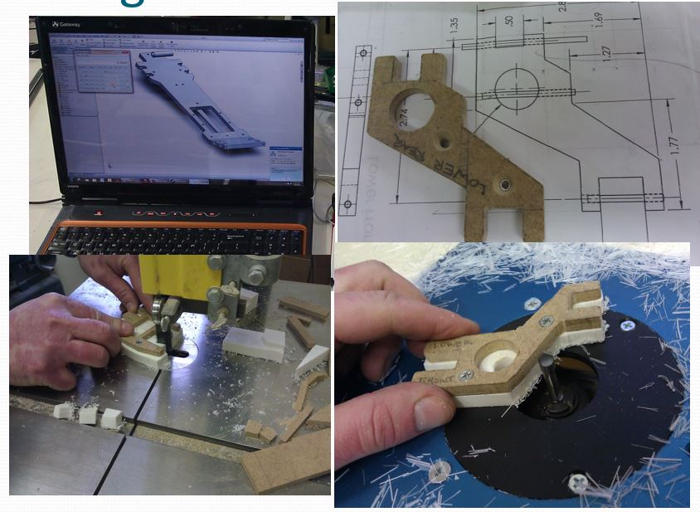
RC Baja Student Competition
Team leader 3 years running, 2010-2012
Coordinated all CAD modeling
Tools used to manufacture:
3D printer
Metal CNC
Laser cutter
Basic wood shop / metal shop

Slide 5
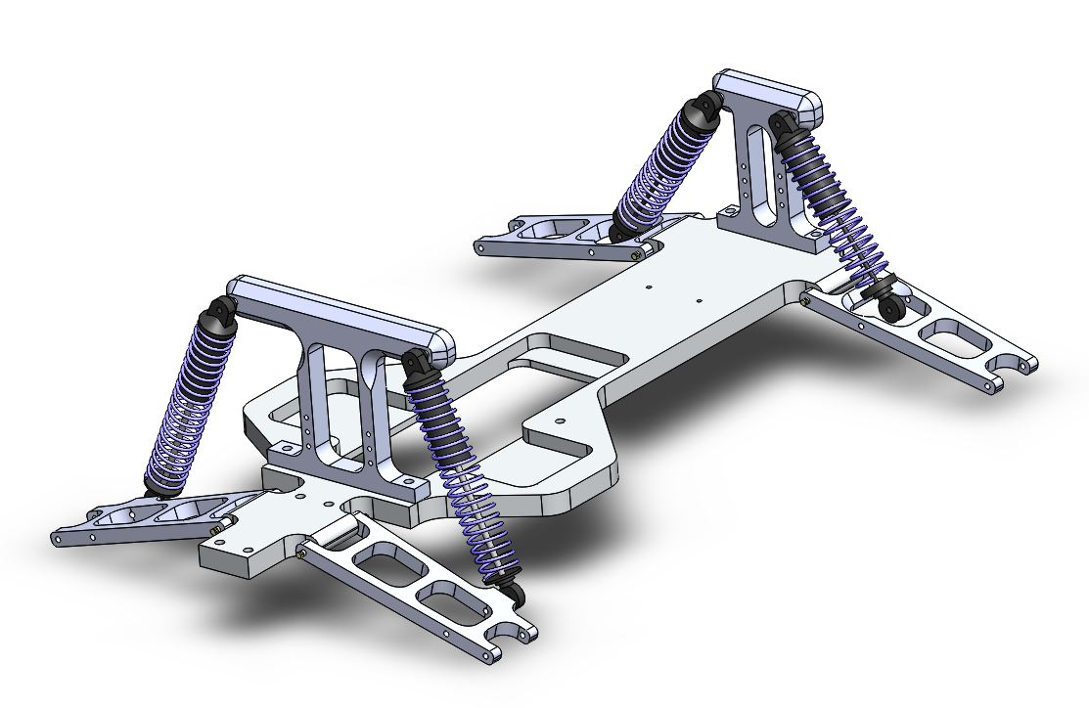
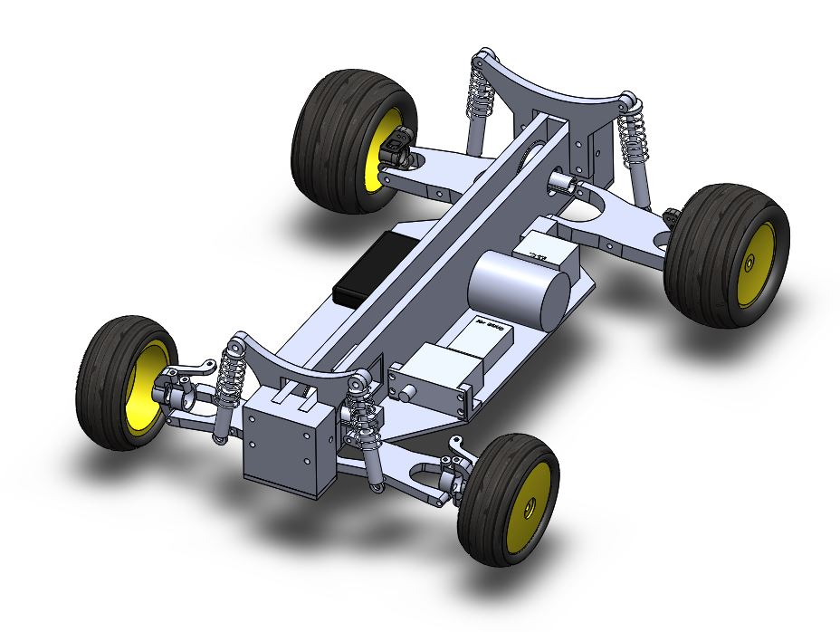
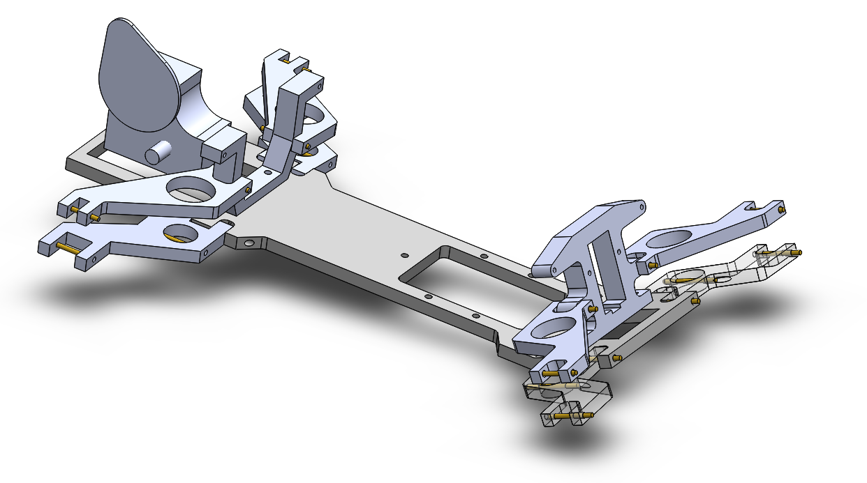
RC Baja Student Competition
Year 1
Year 3
Year 2 (Pictured on previous page)

Slide 6
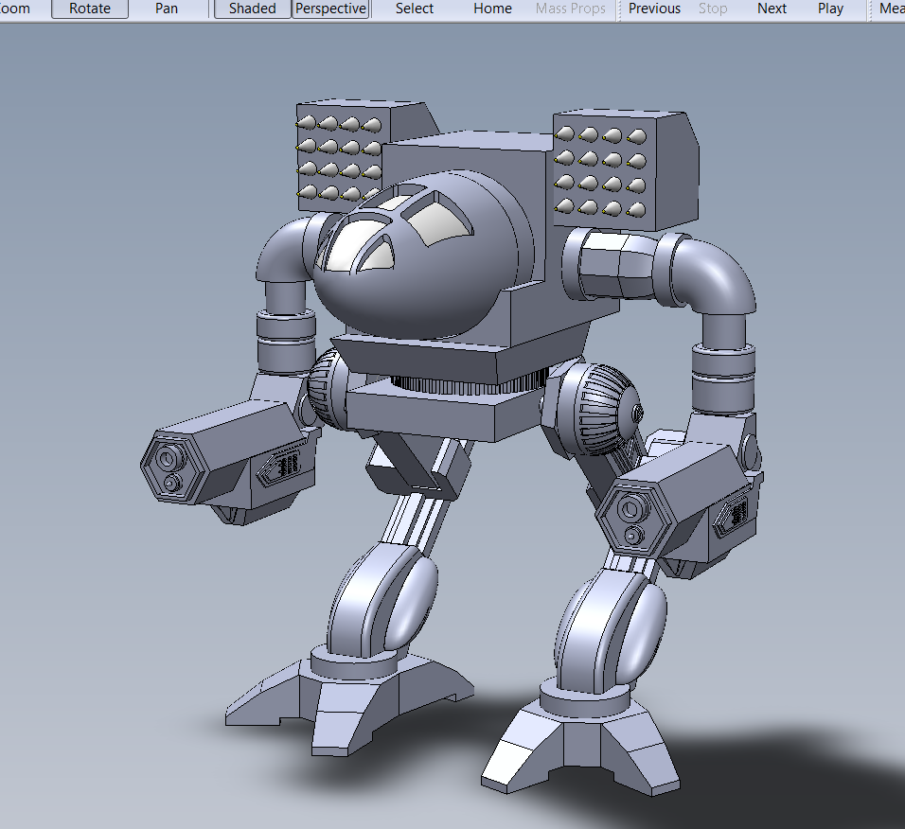
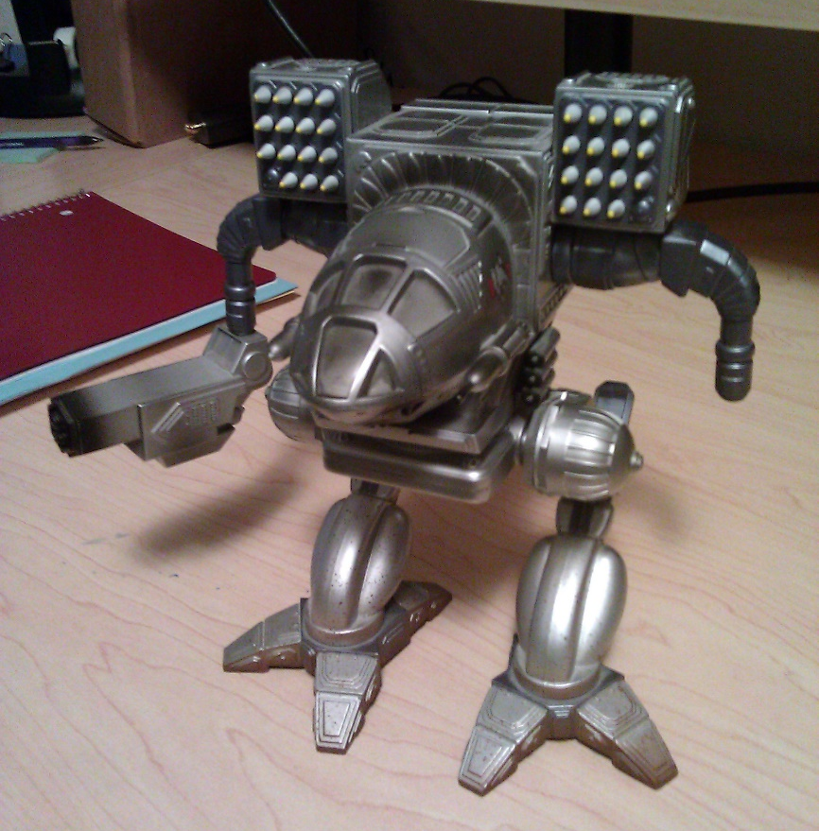
MechWarrior Timber Wolf (aka Mad Cat)
Personal project just for fun (and to keep skills fresh)
Based on a real life reference model:
Version 1, 2014

Slide 7
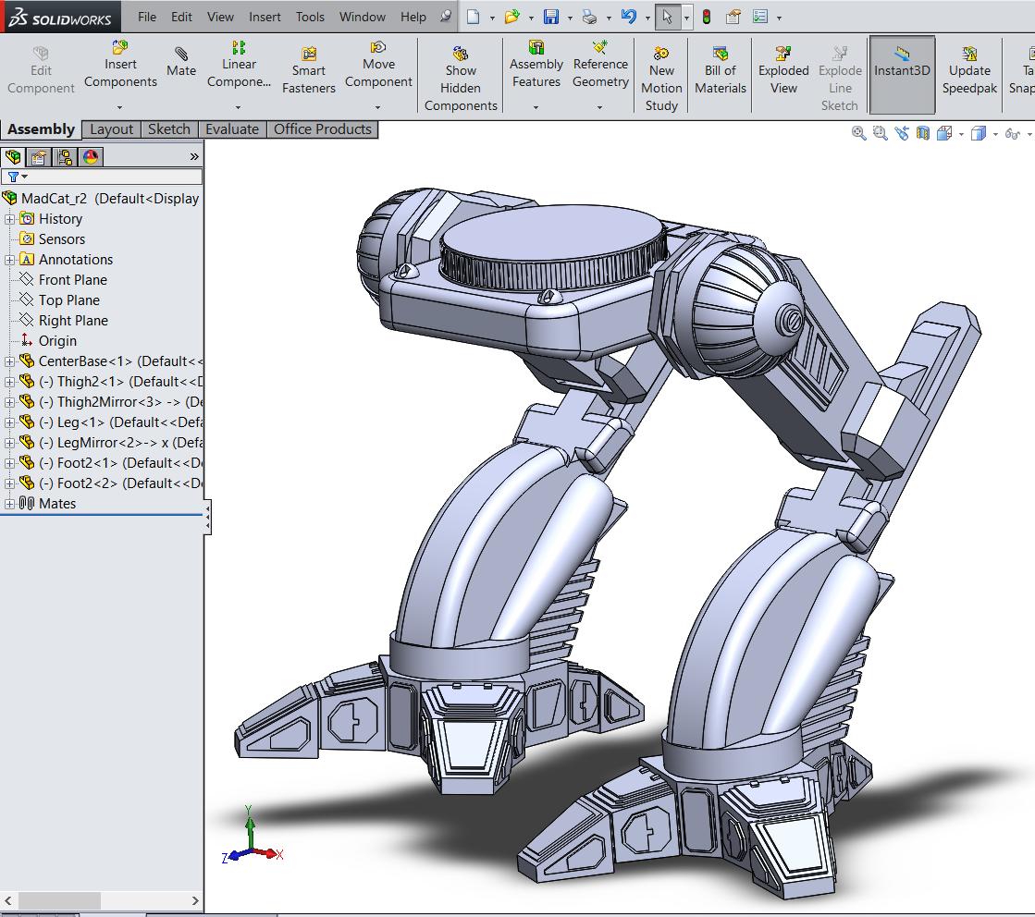
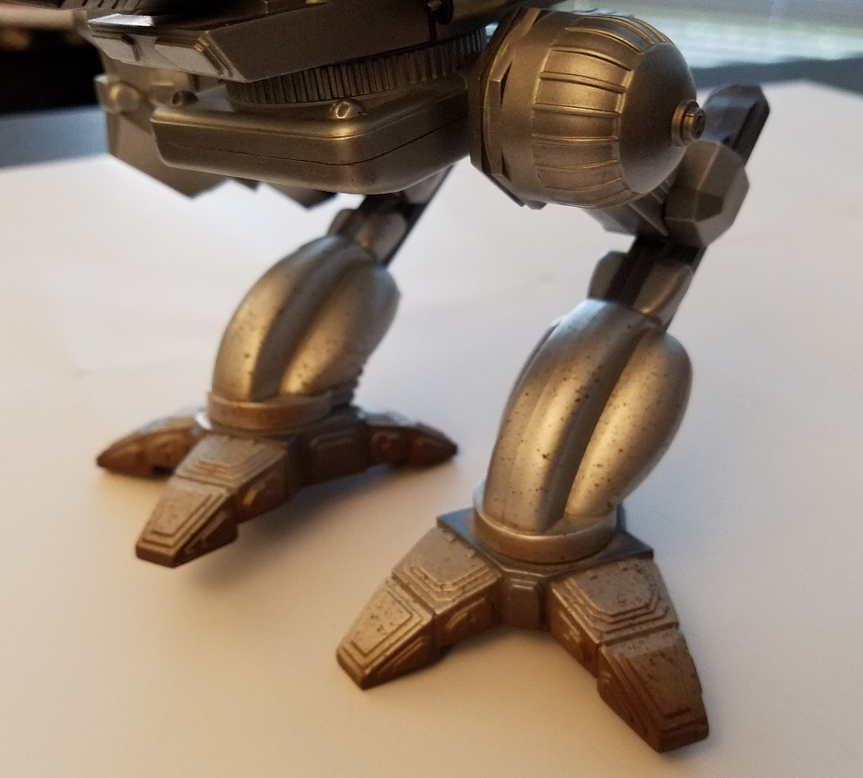
MechWarrior Timber Wolf (aka Mad Cat)
Later revisited to show off improved skills:
Higher detail and accuracy
Version 2, WIP, 2016

